Slide 1
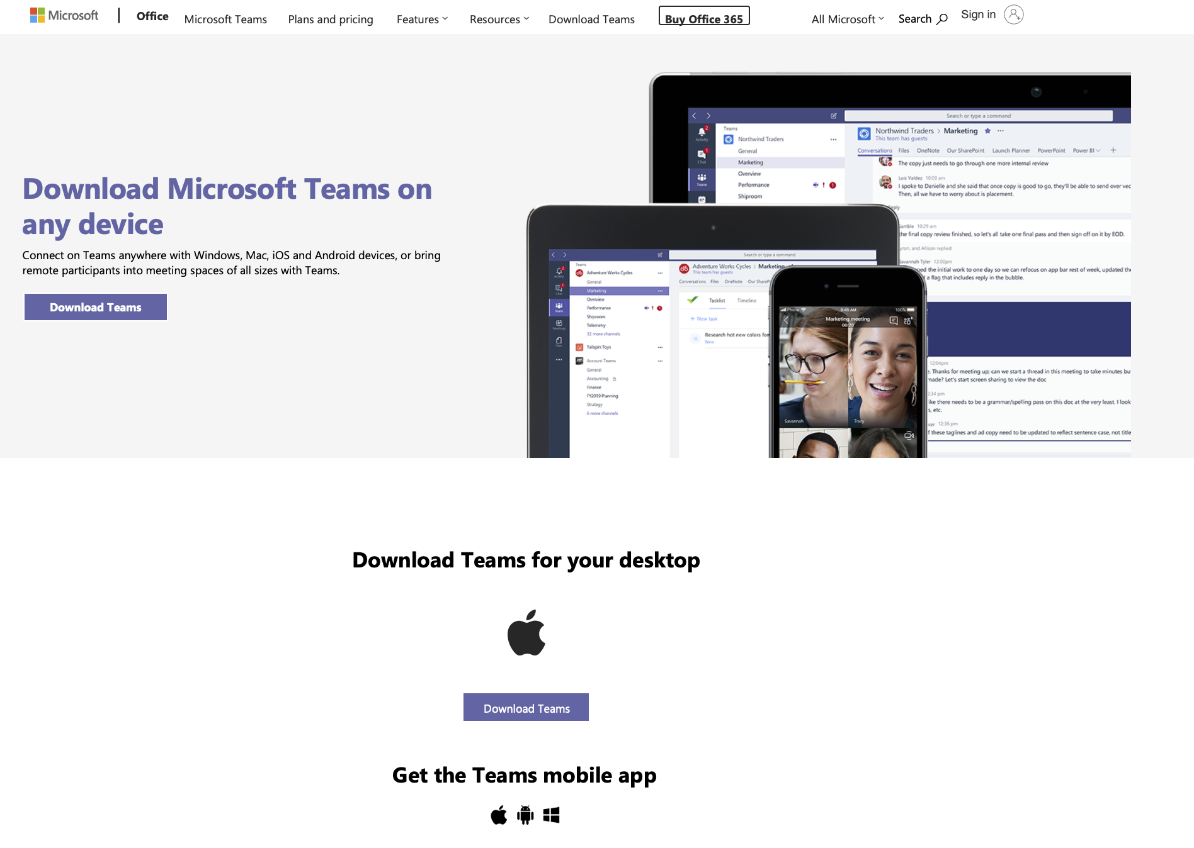
To download MS Team
Click Here

Slide 2
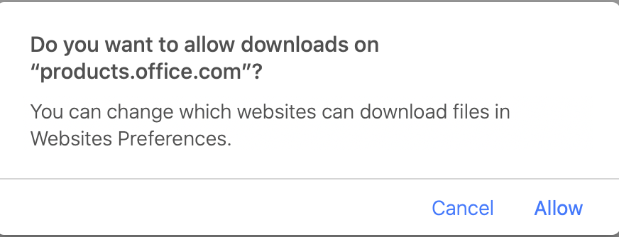
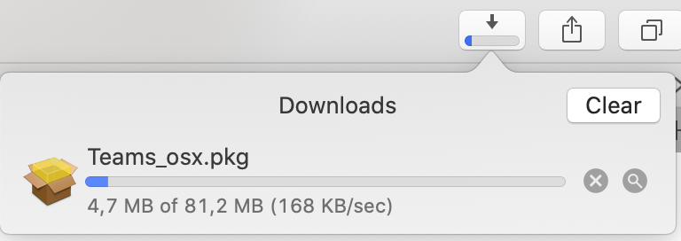
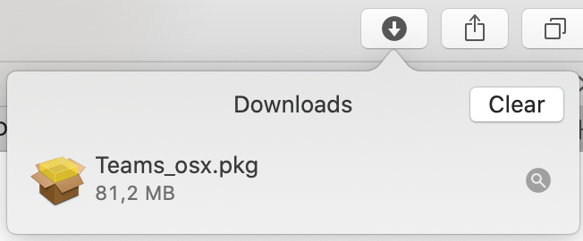
Click on Allow
The Install Package will start to download. You can monitor it by clicking on “Show Downloads” at the top in Safari.
Once completed Double click the downloaded Install file

Slide 3
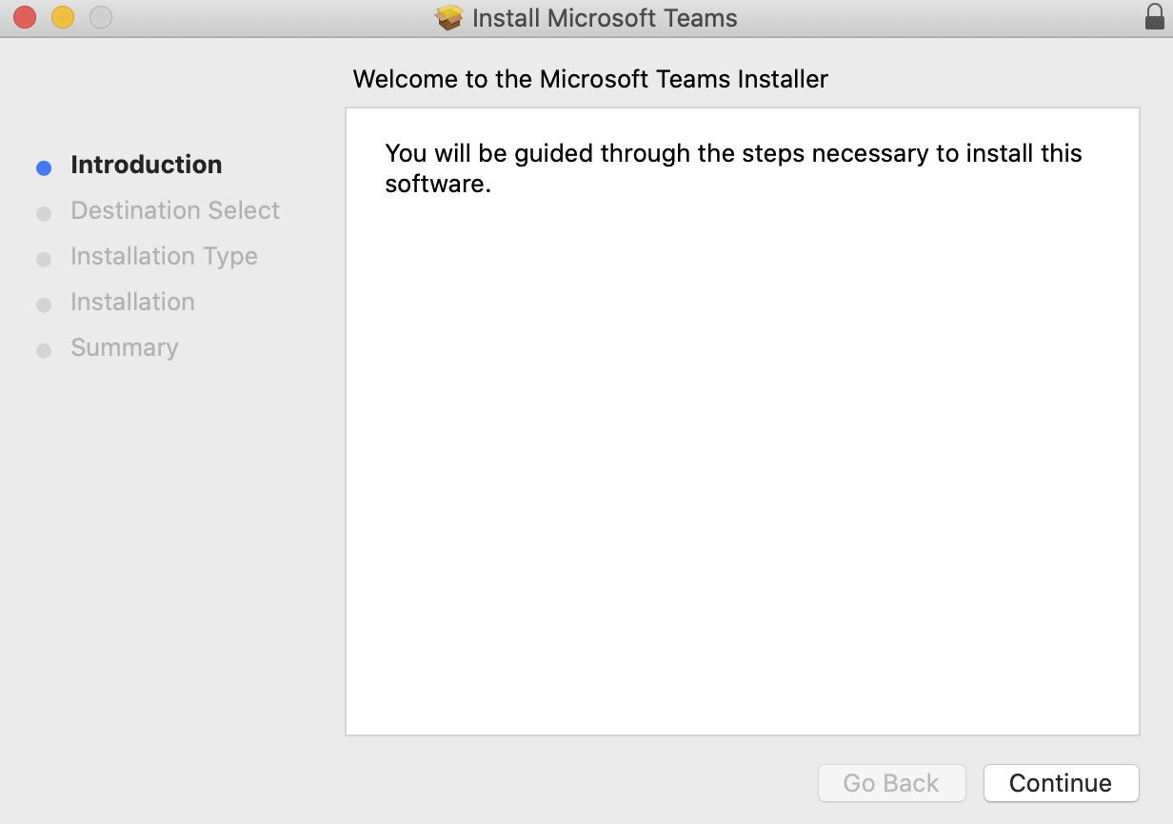
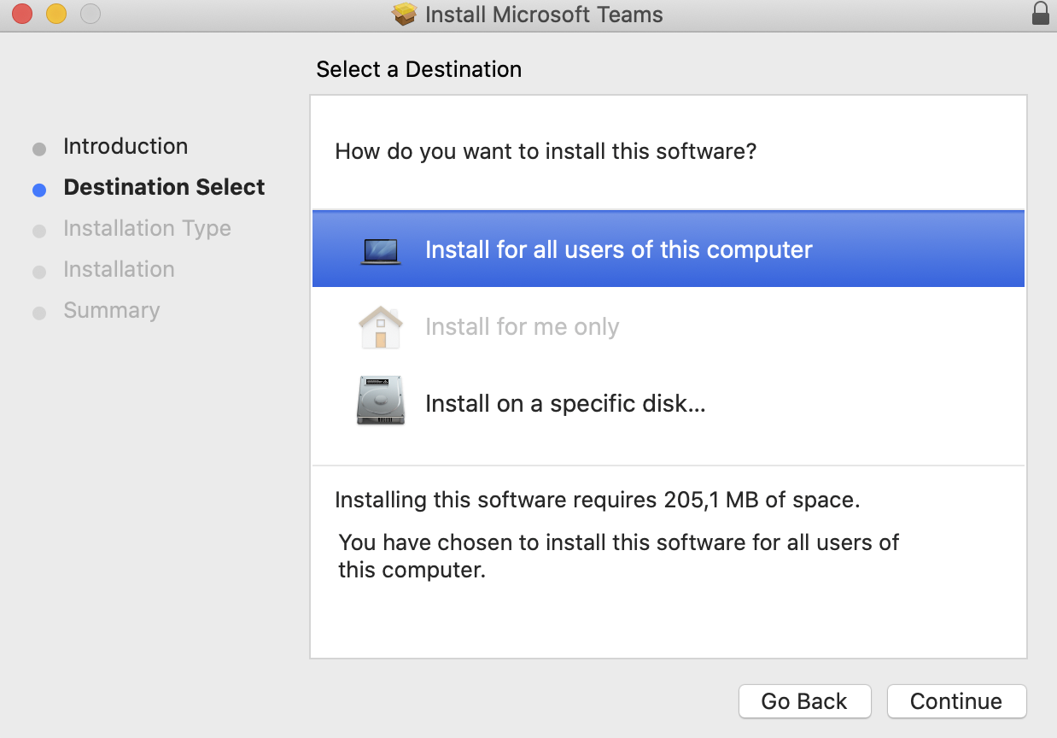
Follow the prompts to install teams

Slide 4
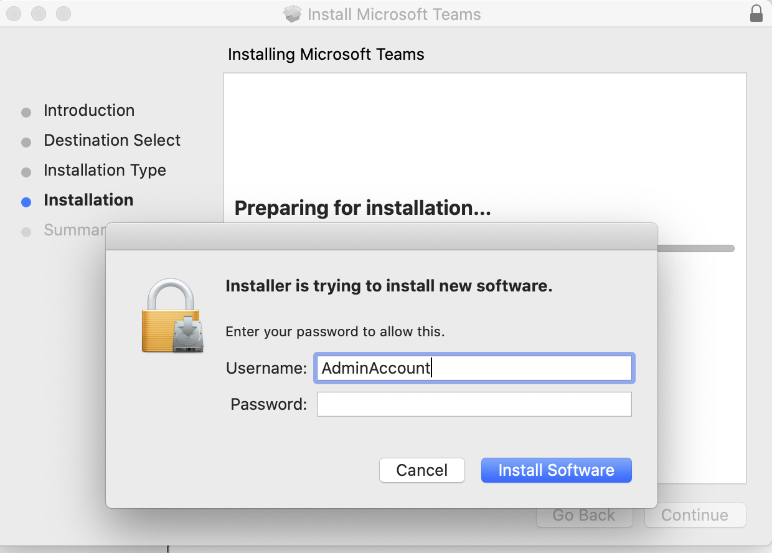
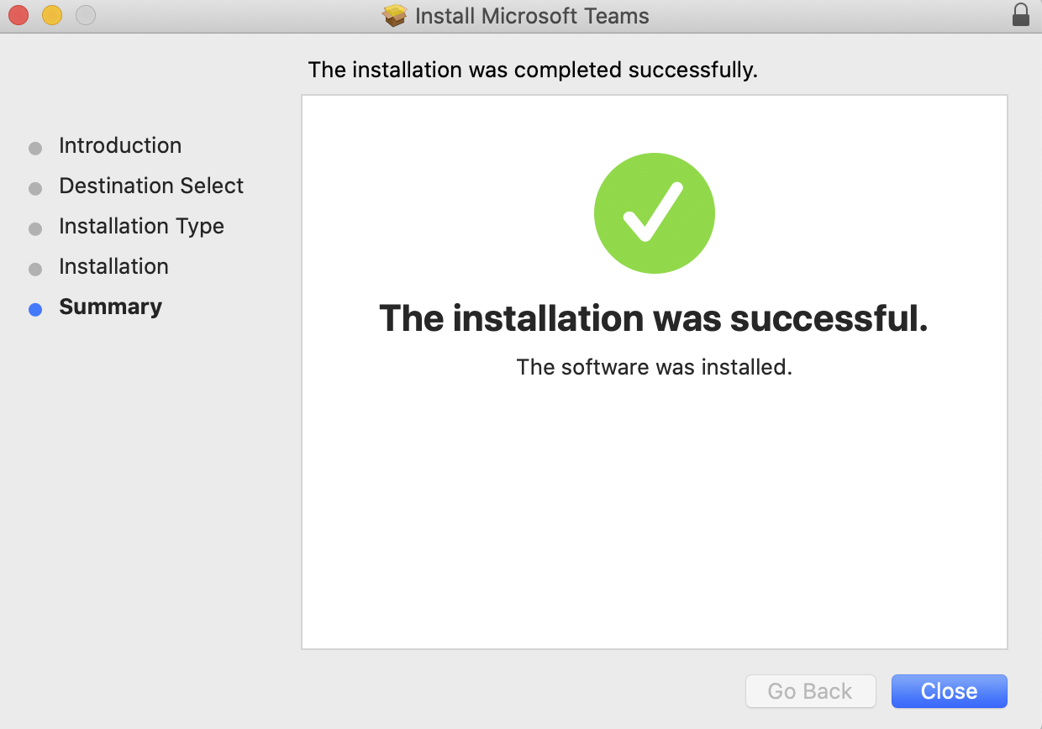
Enter Your credentials
Once completed Close the Installation

Slide 5
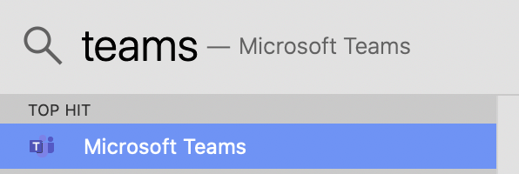
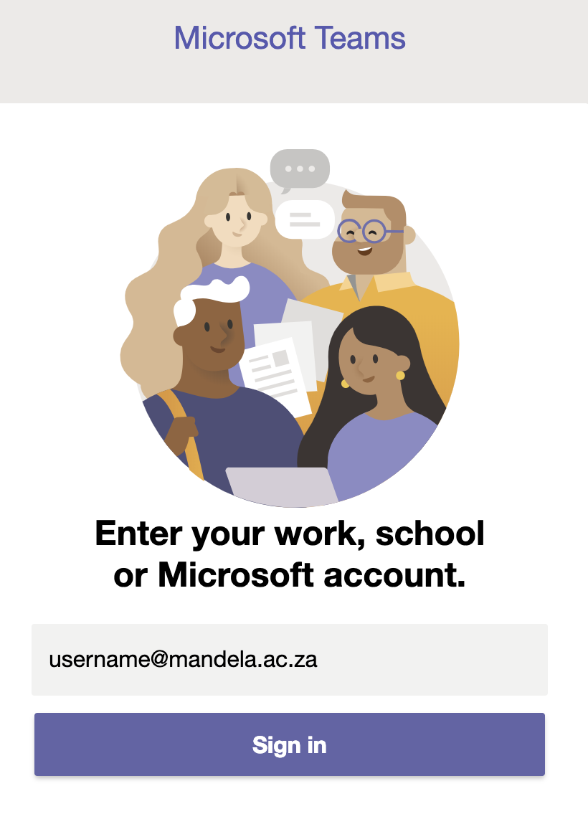
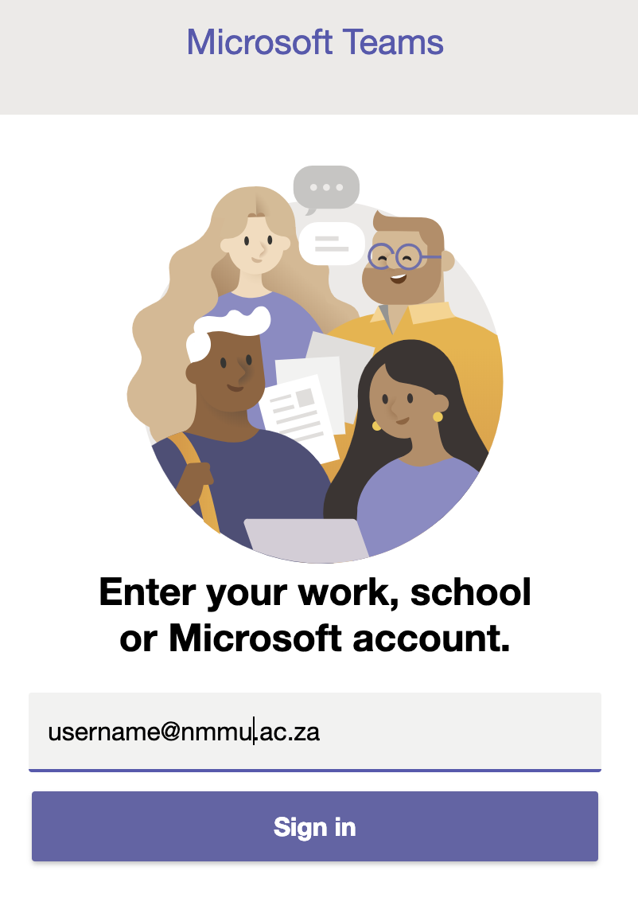
You can find teams Under Applications Folder or on Launch Pad or by using Spotlight to find the Application
Double click to open it
Fill in you Login credentials
username@nmmu.ac.za or @mandela.ac.za

Slide 6
