Slide 1
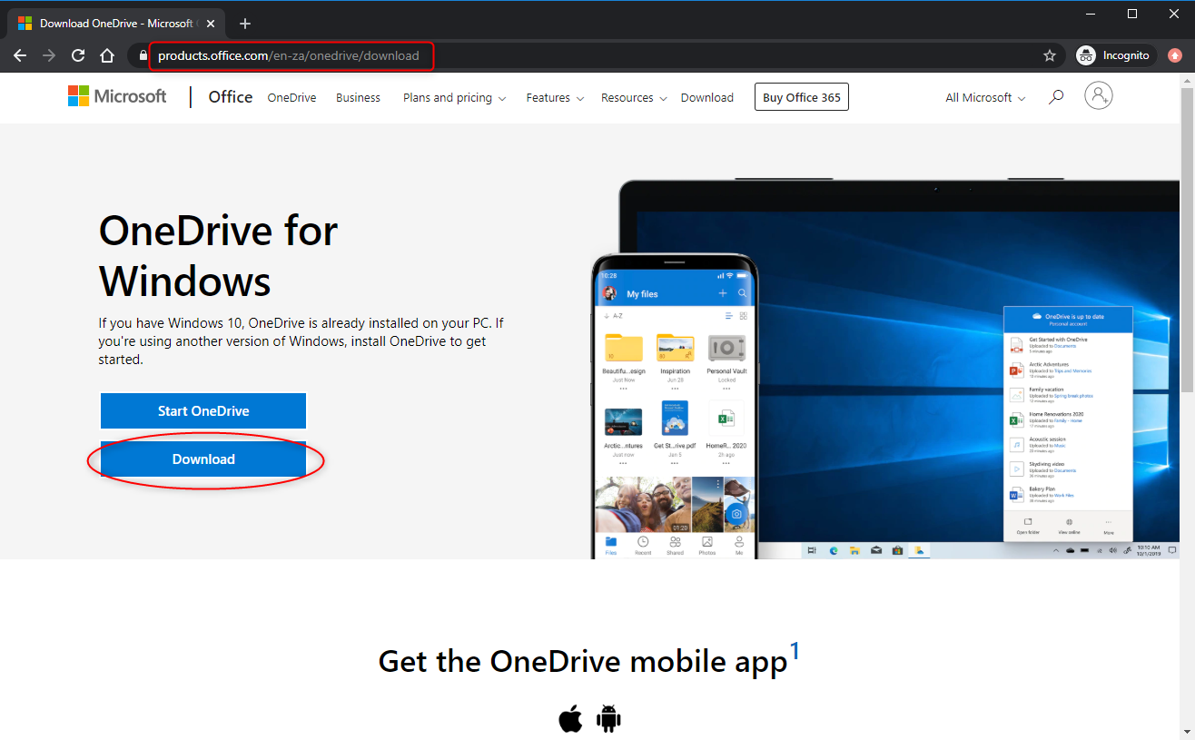
How to Setup OneDrive
Step 1
Download OneDrive from: https://products.office.com/en-za/onedrive/download
Select “Download”

Slide 2
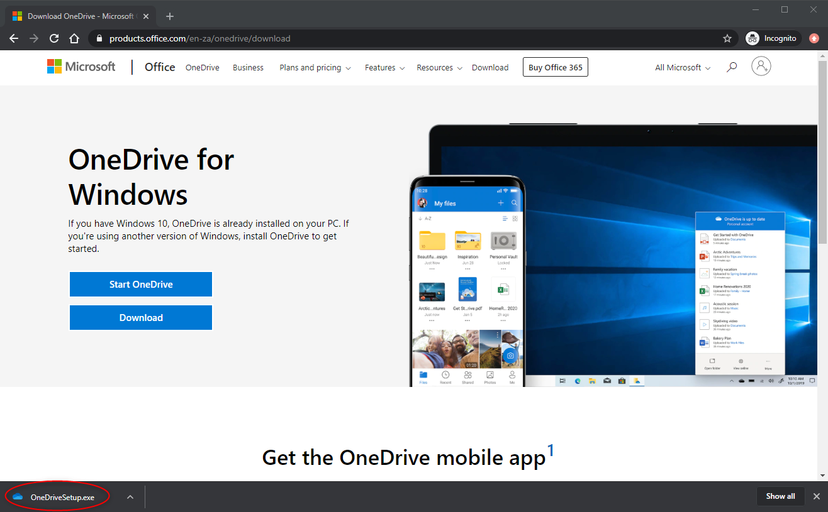
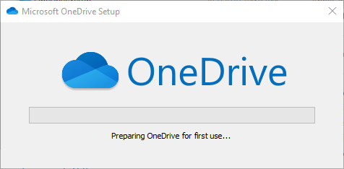
Step 2
Click on “OneDriveSetup.exe” or find the downloaded file in your download folder and double click it to start the setup
OneDrive will install automatically

Slide 3
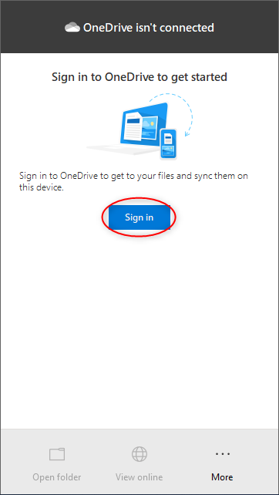
Step 3
When the installation has completed, the OneDrive icon will be visible next to the date and time in the bottom right corner. Click the OneDrive icon and select “Sign In”

Slide 4
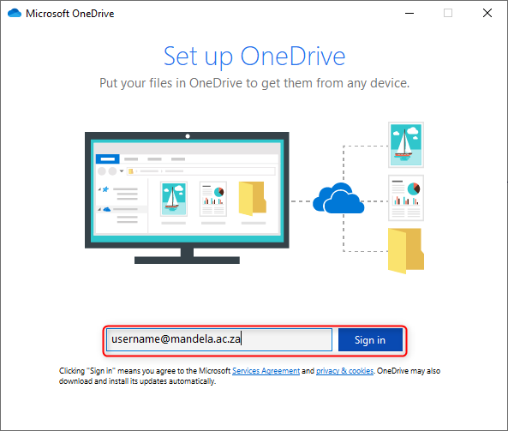
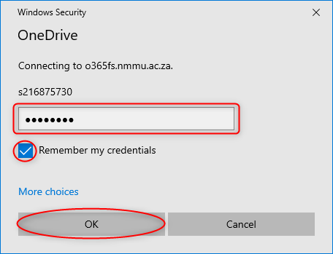
Step 4
Enter your username@mandela.ac.za
Step 5
Enter your password, tick remember my credentials and click “OK”

Slide 5
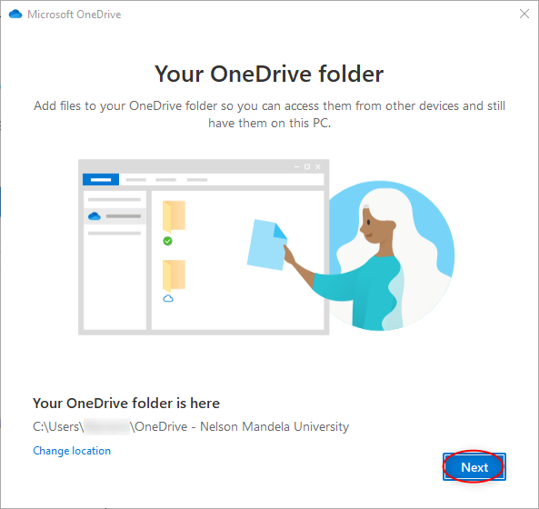
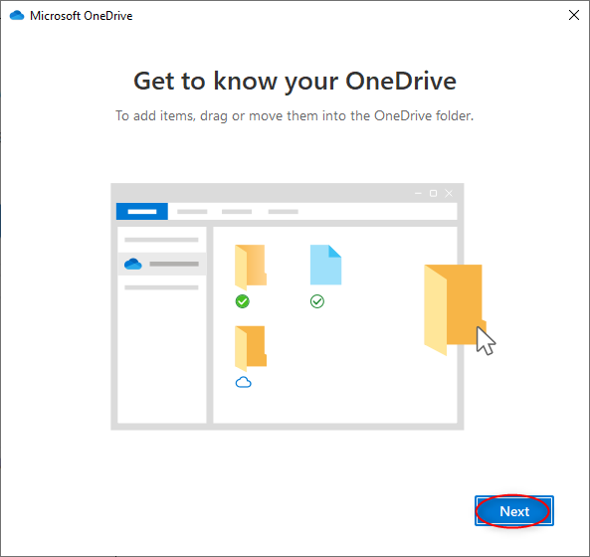
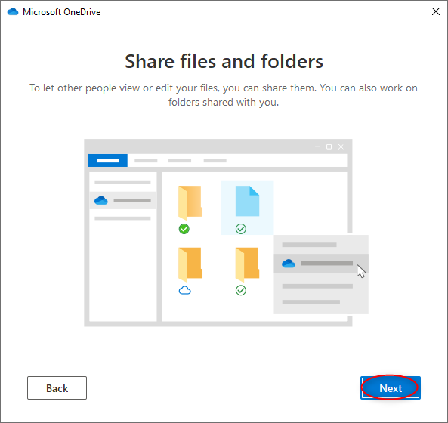
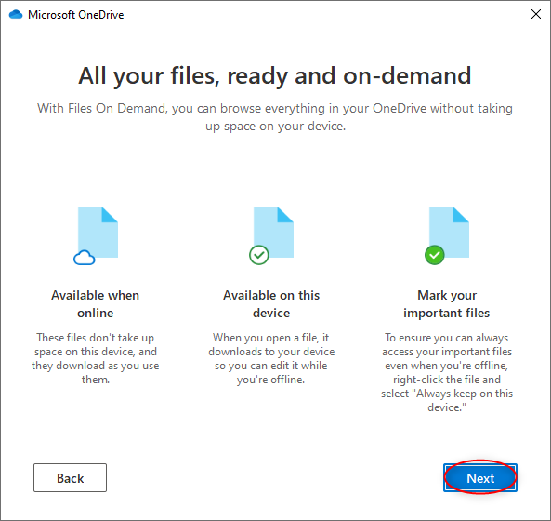
Select “Next” to continue in the following four windows
Step 6
Step 7
Step 8
Step 9

Slide 6
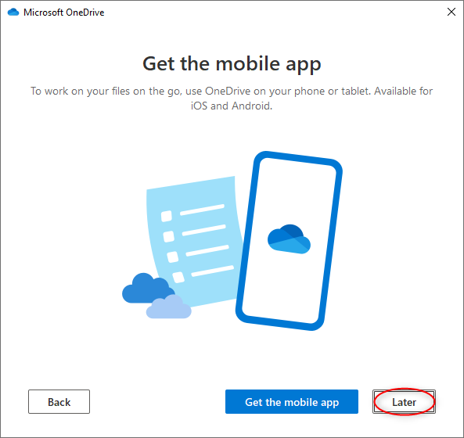
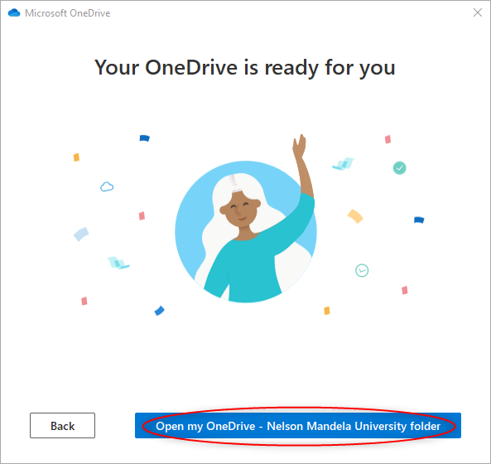
Step 10
Step 11
Select “Later” when asked to download the Mobile App
Select “Open my OneDrive – Nelson Mandela University folder” to show the OneDrive folder

Slide 7
Step 12
The OneDrive folder will open and you may drag and drop files and folders in to the OneDrive folder

Slide 8
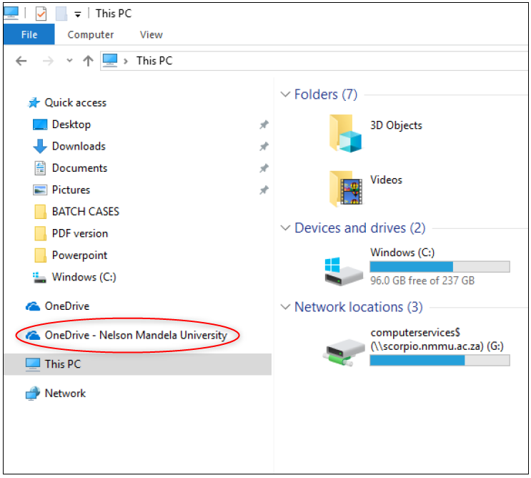
Step 13
The OneDrive folder can be found by using File Explorer and selecting OneDrive – Nelson Mandela University

Slide 9
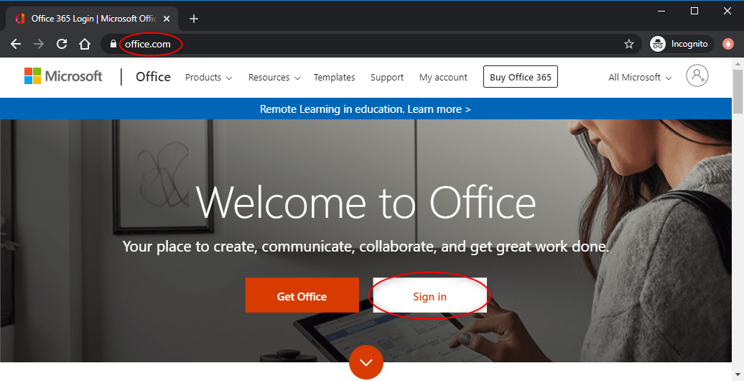
Step 14
OneDrive may be accessed via the web. Enter www.office.com in the address bar of the browser
Select the “Sign In” button

Slide 10
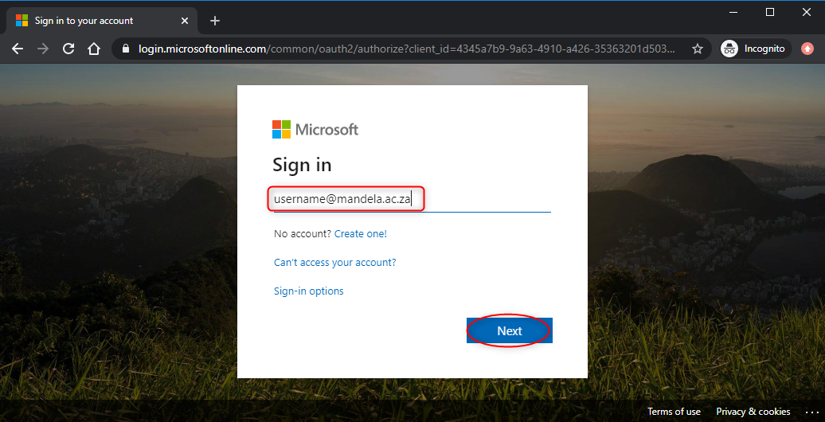
Step 14
Enter your username@mandela.ac.za
If you are still using the nmmu domain, type username@nmmu.ac.za
Select “Next”

Slide 11
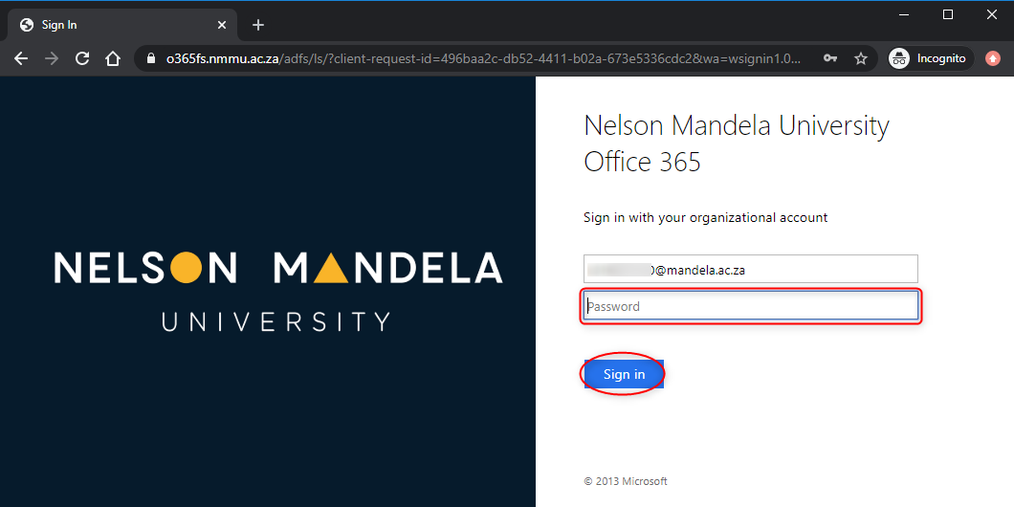
Step 15
Enter your password
Select “Sign In”

Slide 12
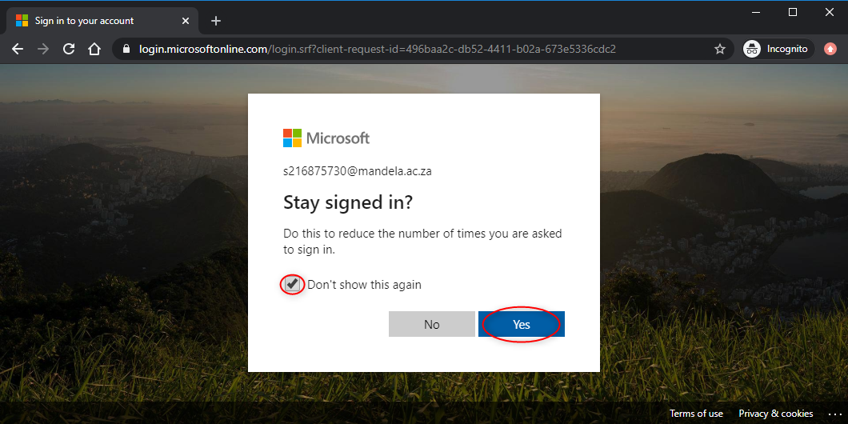
Step 16
Tick remember my credentials and select “Yes”

Slide 13
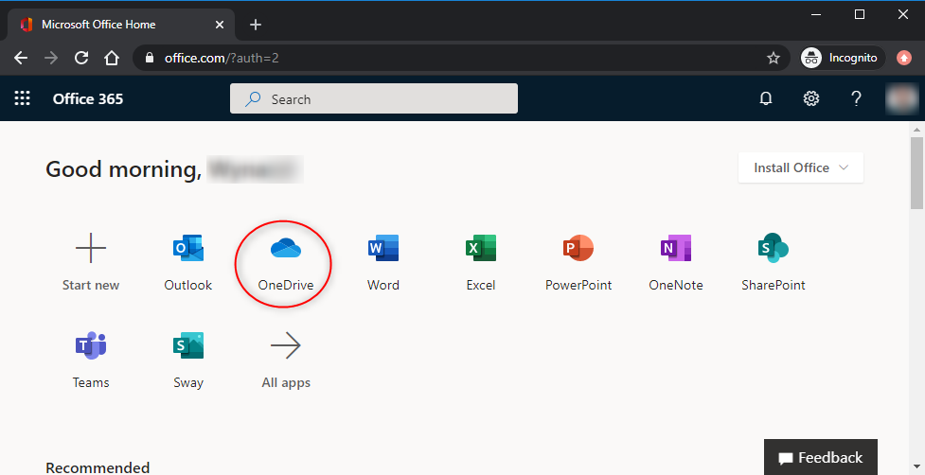
Step 16
Select “OneDrive”

Slide 14
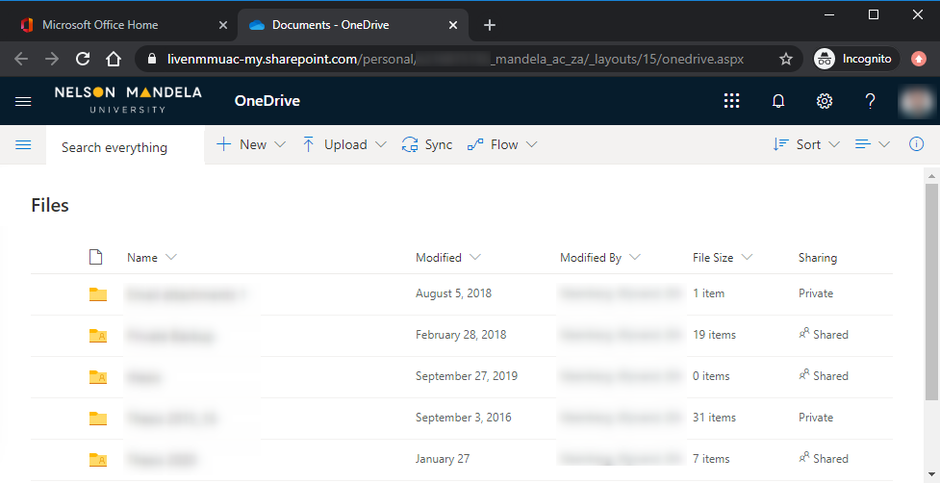
Step 17
The OneDrive webfolder will open and you may drag and drop files and folders in to the OneDrive folder

