Slide 1
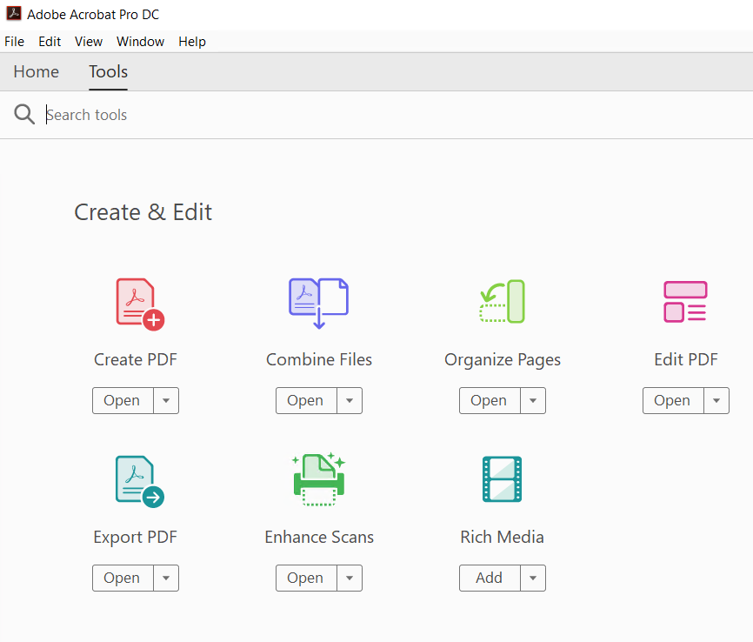
How to combine and merge your files into one PDF
Open Acrobat DC to combine files
Open Acrobat DC to combine files

Slide 3
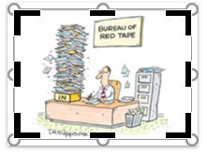
Open the Tools tab and select "Combine files."
Add files: Click "Add Files" and select the files you want to include in your PDF. You can merge PDFs or a mix of PDF documents and other files.
Arrange and delete content: Click, drag, and drop to reorder files or press "Delete" to remove any content you don't want.
Combine files: When you're finished arranging, click "Combine Files".
Save as a PDF file: Name your file and click the "Save" button. That's it.
Black crop handles appear on the edges and corners of the picture

