Slide 1
ITS Printing Setup on PCounter

Slide 2
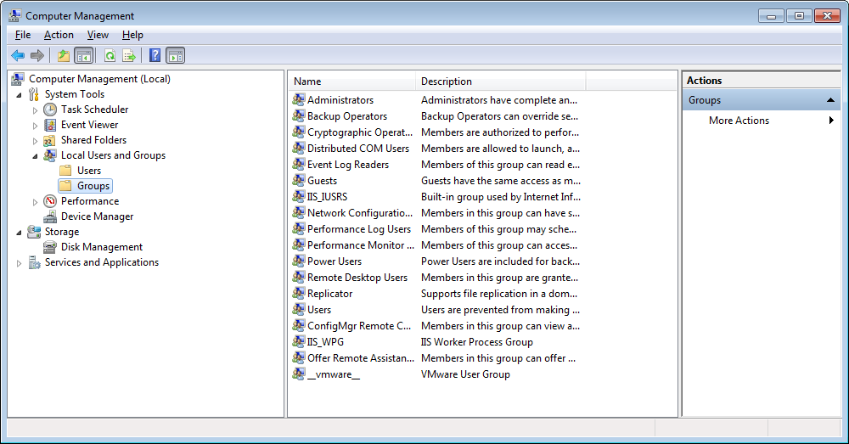
Check that the user has admin rights on the machine
On user’s pc
Goto Start
Right-click Computer
Goto Manage
Goto Local Users and Groups
Double-click Administrators on the right pane

Slide 3
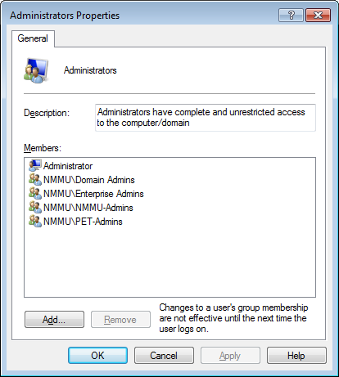
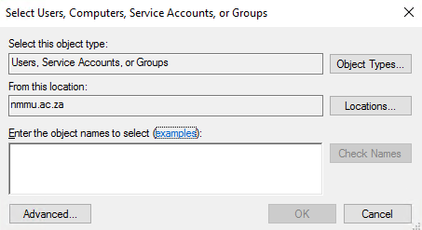
Restart the pc after applying settings

Slide 4
Check that the LPD and LPR Print Services have been installed
Control Panel
Programs and Features
Turn Windows Features on or off

Slide 5
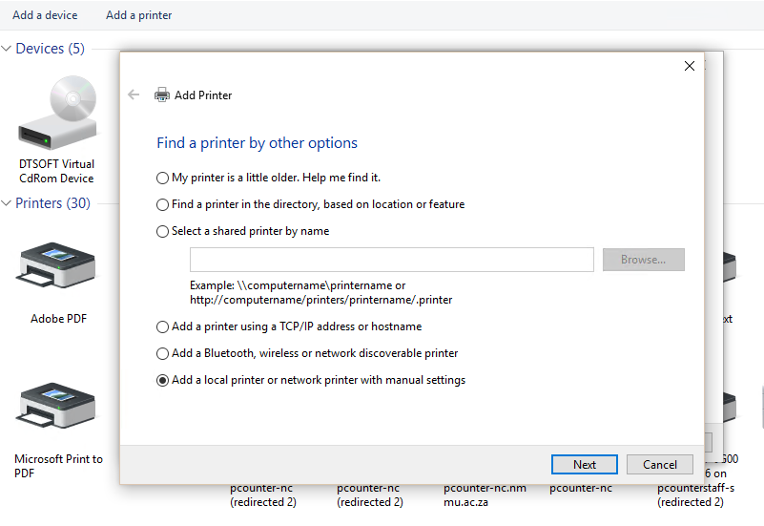

Slide 6
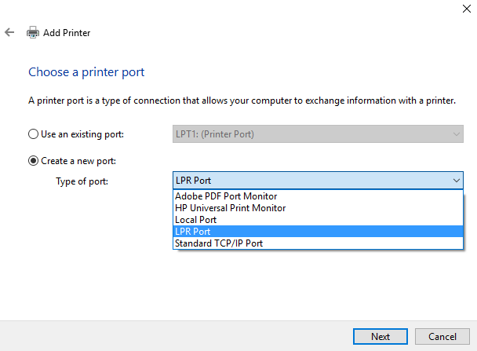

Slide 7
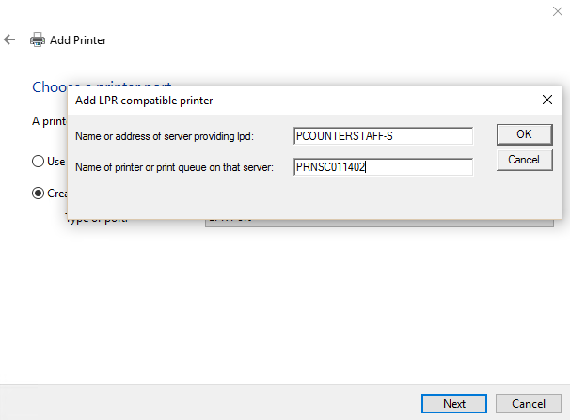
This information will be in the jobcard or it can be obtained from Ian or Nadia
Click OK and install the driver for the printer
\\pcounterstaff-s\drivers$

Slide 8
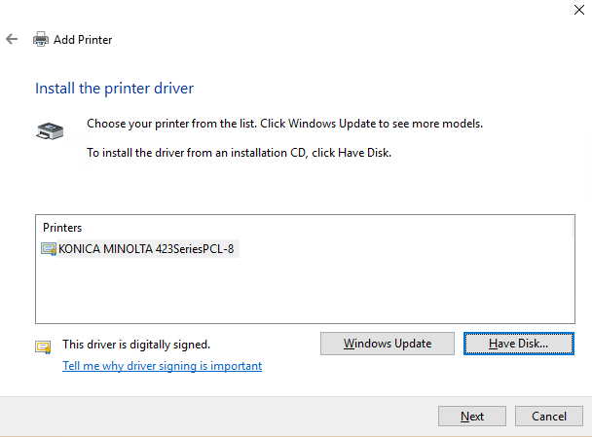
The 223 and 423 use the same Driver

Slide 9
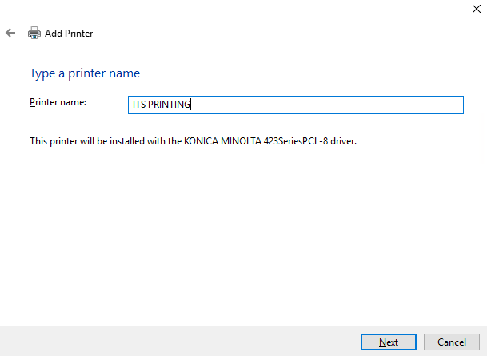
Rename the Printer to (ITS PRINTING)

Slide 10
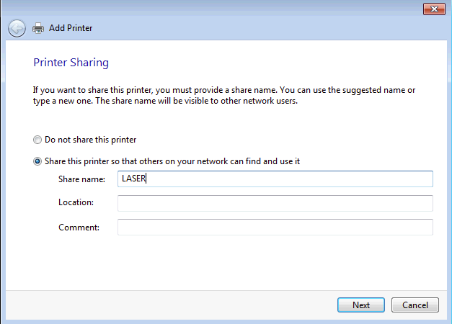
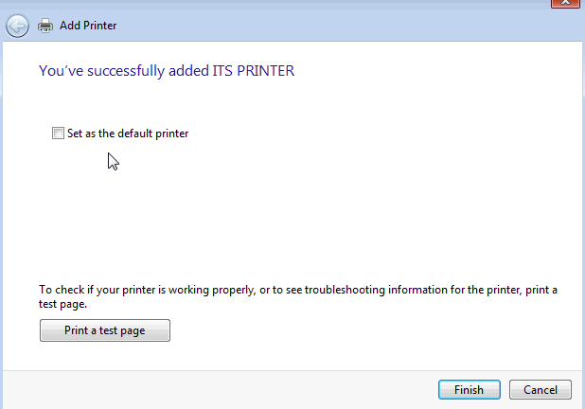
SHARE IT AS LASER in caps

Slide 11
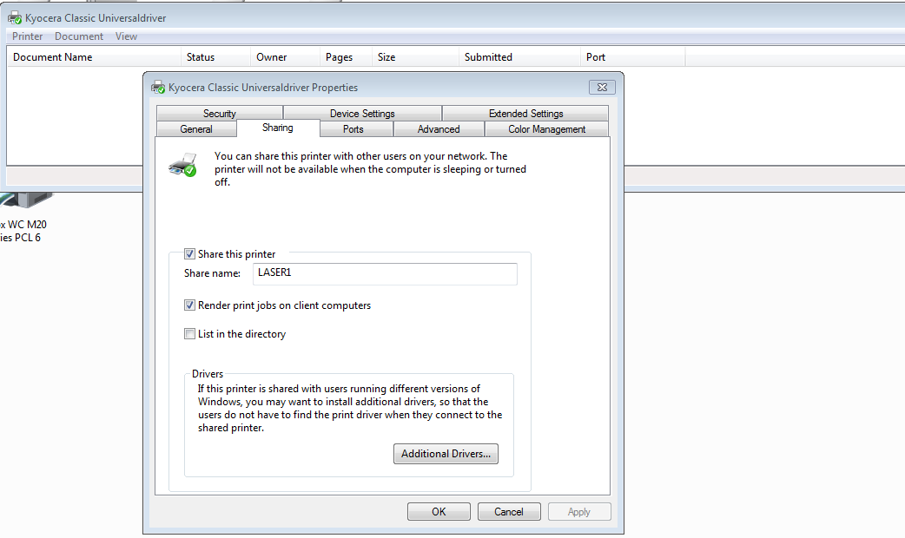
If user has a desktop printer
Change the share of the desktop to ‘LASER1’

Slide 12
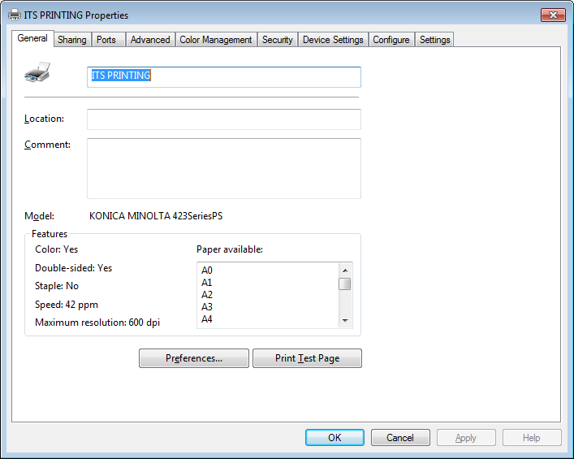
Open the Printer Properties and go to the Ports settings

Slide 13
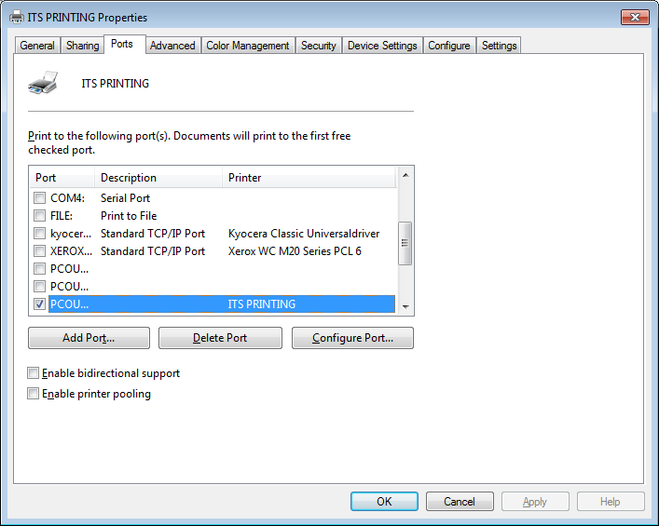
Make sure that you untick the box : Enable bidirectional support

Slide 14
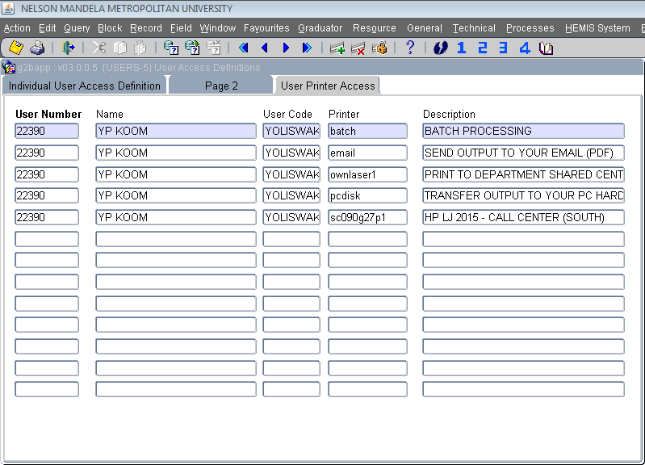
Add printer to ITS Profile
Add ownlaser1 printer to user’s profile

