Slide 1
Crop a picture in Office
How to crop a picture to trim away outer edges that are unnecessary.
Add your picture
Double click on the picture or Click Picture Tools > Format, and in the Size group, click the arrow under Crop to give various crop options
Black crop handles appear on the edges and corners of the picture

Slide 2
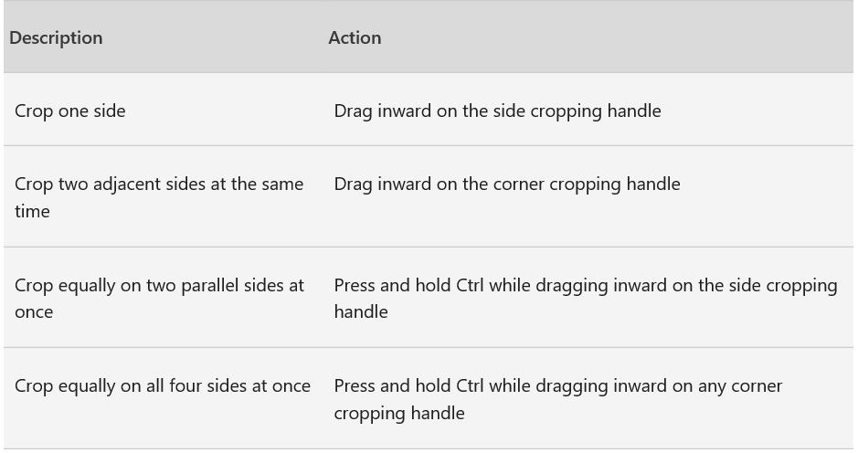
Crop the image by doing one of the following:
Click the Crop button again when you are done
You now have successfully cropped a picture.

